Slide 1
Style Transfer from
Real Faces to Cartoon
Group 05
Lu Yuhao, Xue Chuhui, Wu Rongliang, Zhan Fangneng
Github: https://github.com/LUYU0004/CE7454_Project_Group_5

Slide 2
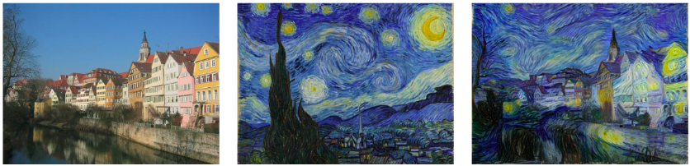
Project Motivation
Style Transfer
Generative Adversarial Network (GAN)
Content image
Style reference
Result

Slide 3

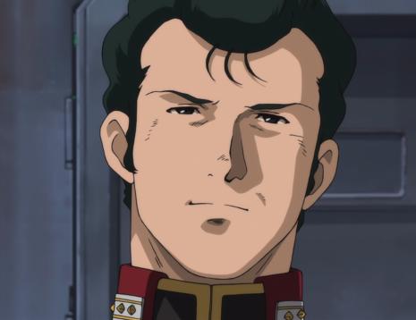
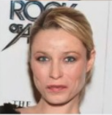
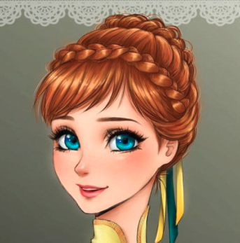
Project Description
Recent advanced architecture: CycleGAN, StarGAN, etc.

Slide 4
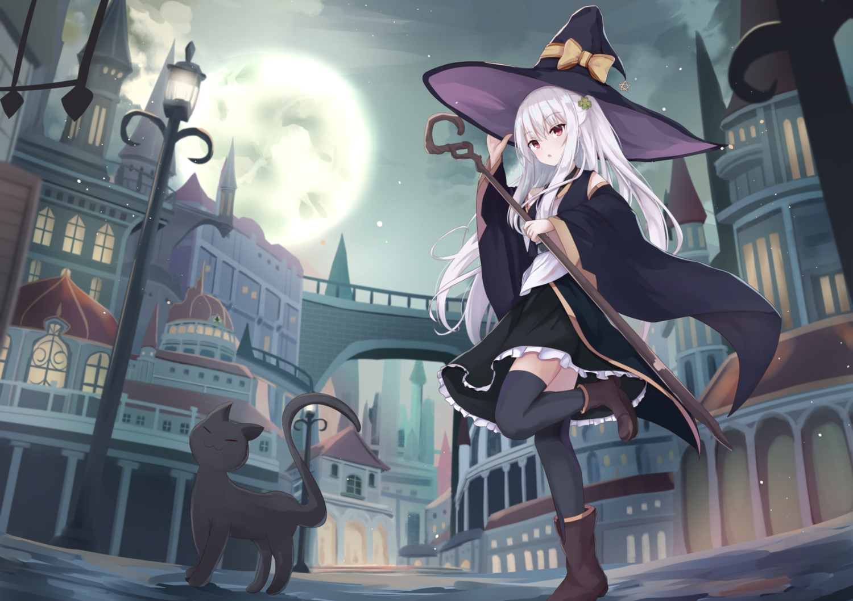
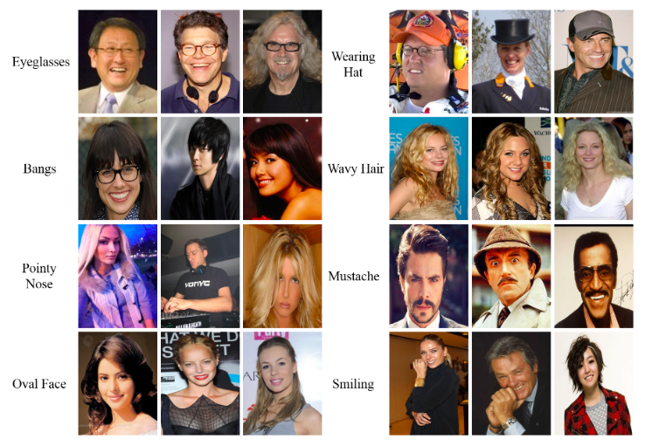
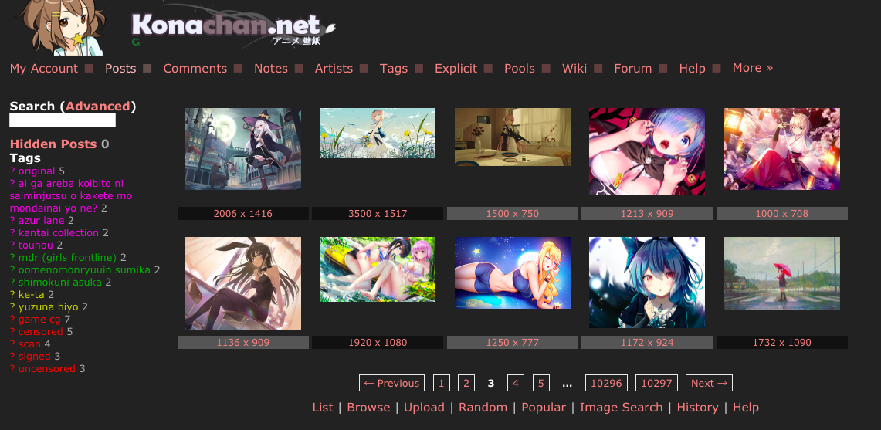
Data Preparation
Data Acquisition
Data Exploration
Pre-processing
Real Images:
CelebA Dataset
Cartoon Images:
Download anime images from http://konachan.net/
Contain noise parts including background, bodies, etc.
Detect anime faces from original images
Crop anime faces
Filter and resize
Obtained more than 50,000 face images.
Haar Feature-Based Classifier provided by OpenCV
Pre-trained anime face detector provided by https://github.com/nagadomi/lbpcascade_animeface
Filter noise data:
False detection
Small faces
Resize to same size

Slide 5
Models Overview
A neural algorithm of artistic style
End-to-end neural style transfer
CycleGAN
StarGAN
CartoonGAN

Slide 6
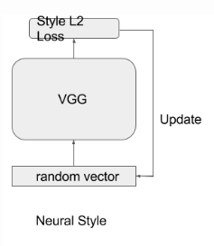
Model 1 - [A neural algorithm of artistic style]
The 1st to introduce the idea of neural style transfer
Use pre-trained VGG16
Define style loss and content loss
Combine both to optimize the input image
c
c
Gatys, Leon A., Alexander S. Ecker, and Matthias Bethge. “A neural algorithm of artistic style.” arXiv preprint arXiv:1508.06576 (2015)..
Notes:
Intro what is neural algorithm;
Intead of VGG16, VGG19
Tuning alpha and beta do not have much effect, in contrast with model 2, alpha=1, beta=1000000

Slide 7
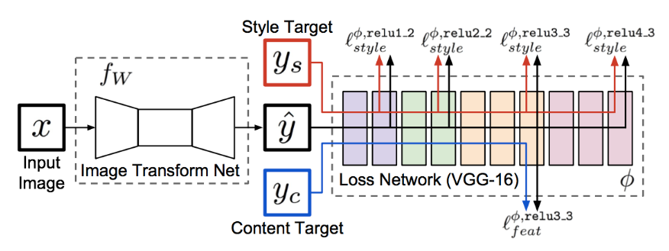
Model 2 - [End-to-end neural style transfer]
Johnson, Justin, Alexandre Alahi, and Li Fei-Fei. “Perceptual losses for real-time style transfer and super-resolution.” arXiv preprint arXiv:1603.08155(2016).
Notes:
Convolutional neural network with residual blocks and strided & fractionally-strided convolutions for in-network downsampling and upsampling.
Output is the same size as input image, but rather than training the network with a per-pixel loss, it is trained with a feature reconstruction perceptual loss.
Limitation: model 1 (1-to-1), model 2(many-to-1style),

Slide 8
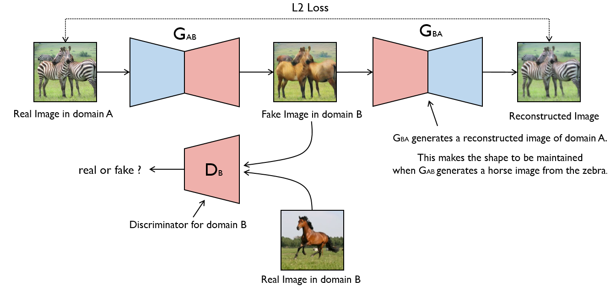
Model 3 - [CycleGAN]
JJun-Yan Zhu, Taesung Park, Phillip Isola, Alexei A. Efros. “Unpaired Image-to-Image Translation using Cycle-Consistent Adversarial Networks”, ICCV, 2017
Notes:
Pros: instead of having 1 style represented by 1 image, implicit X->Y mapping by cyclic reinforcement

Slide 9
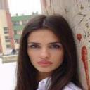
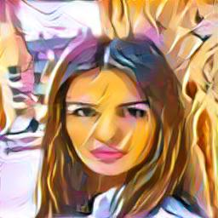
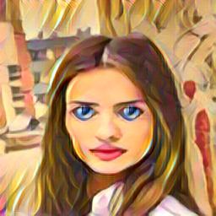
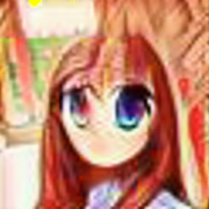

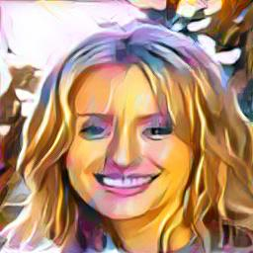
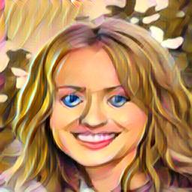
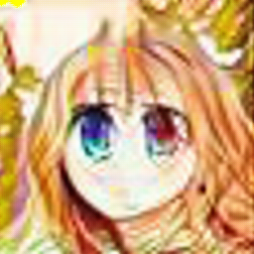
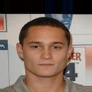
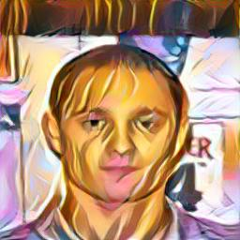
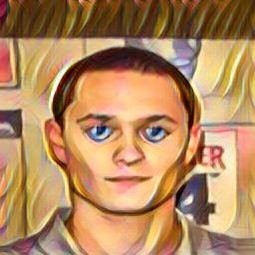
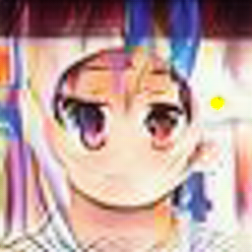
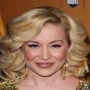
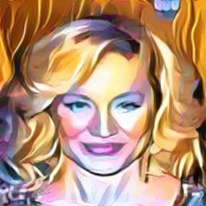
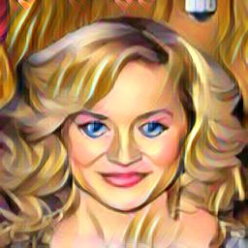
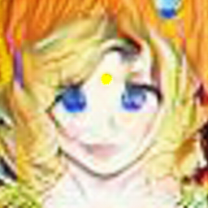
Results on our dataset
Input-> Neural->
End2end -> CycleGAN

Slide 10
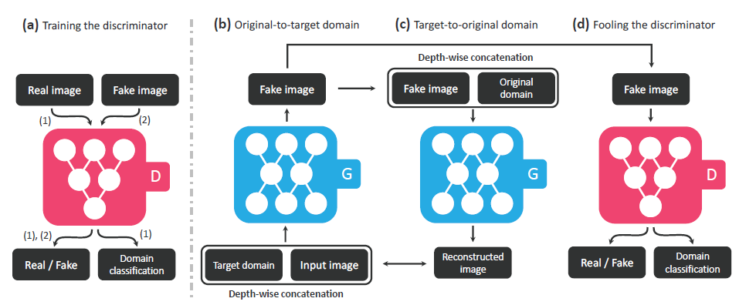
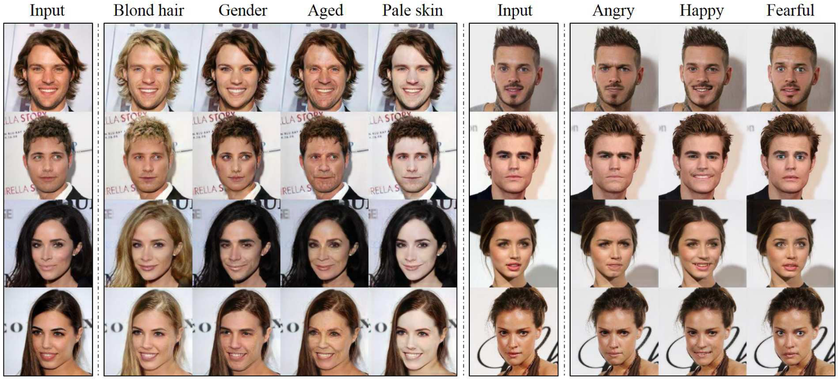
StarGAN

Slide 11
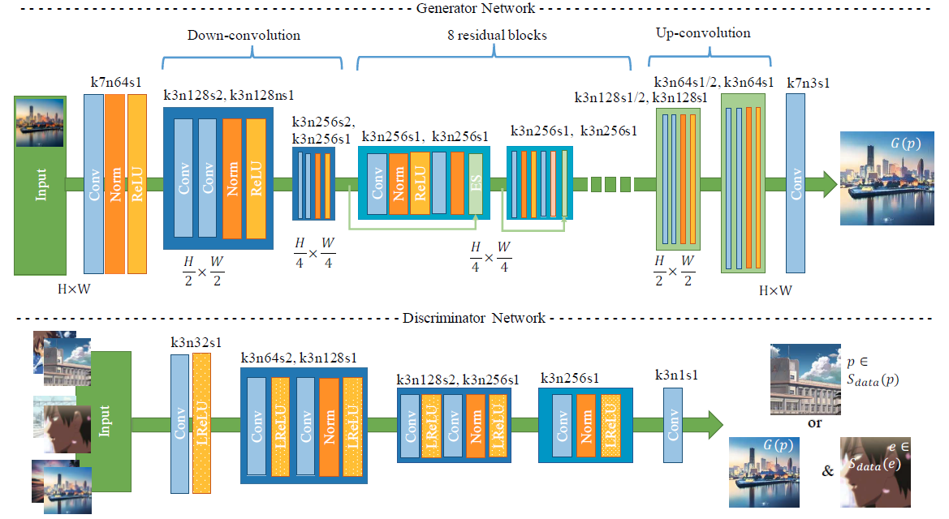
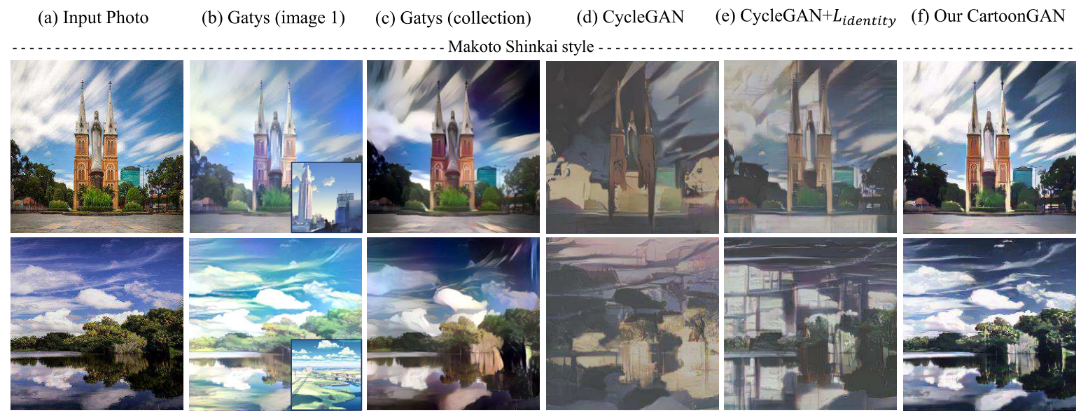
Cartoon GAN

Slide 12
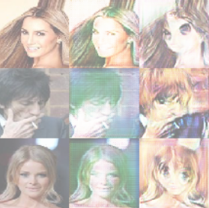
Results on Our Dataset
From left to right: Input, results of StarGAN, CartoonGAN

Slide 13
Analysis
1. With cycle consistent loss, StarGAN can preserve the attributes of the input images
2. Cartoon GAN can transfer the real face into cartoon images, but misses lots of details

Slide 14
Cartoon Portrait GAN（CPGAN）
1. Apply cycle consistent loss for preserving the identity information, unlike CycleGAN, we only have one Generator and one Discriminator in our network architecture.
2. In addition to the images, we forward corresponding labels information to G and D to make them differentiate images from different domain (cartoon / real)
3. Apply perceptual loss to enhance the cartoon style and preserve the attributes of real faces better
4. Apply smoothness loss to generate images with better quality

Slide 15
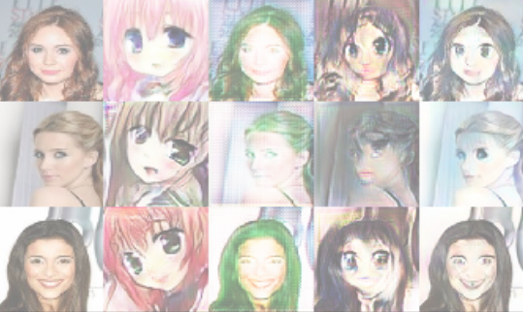
Results
Input BasicGAN StarGAN CartoonGAN CPGAN
Basic GAN: the network that shares the same architecture with our proposed CPGAN but trained with WGAN-GP only.

Slide 16
Evaluation
We adopt 3 methods to evaluate the GAN models Qualitatively and quantitatively.
1. Translation samples
2.Classification task to evaluate the quality of synthesized images.
3.AMT user study.

Slide 17
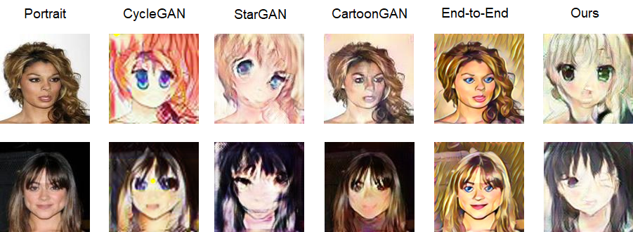
Translation Samples

Slide 18
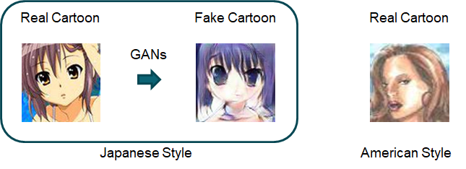
Classification task
A classification model to distinguish Japanese and American style cartoon.
Trained on the images generated by GANs, Test on the Real images.

Slide 19
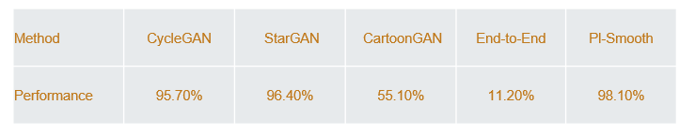
Result

Slide 20
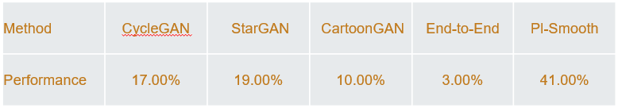
AMT user study.
Turkers in AMT helps to distinguish the image are real or synthesized.
A higher real rate means a better GAN.
Result：

Slide 21
Analysis
1. Cartoon GAN and End-to-End preserve the feature of the origin images, while the style translation is terrible.
2. CycleGAN and StarGAN achieve good style transfer, while the quality of synthesized image are not well (low resolution, many noise).
3. Our own designed GAN can achieve style transfer and generate images with good quality.

Slide 22
Contributions
Data acquisition, exploration and preprocessing: Xue Chuhui
Implementation: Lu Yuhao, Wu Rongliang
Evaluation and analysis: Zhan Fangneng

